Slide 1
MODELING DIABETES RISK INDICATORS
Zoë Levings
Vanshika Sapra
Monica Jang
Tina Faraji
Notes:
Hi everyone, today our group will be presenting our project on modeling diabetes risk using various indicators.

Slide 2
AGENDA
01
RECAP
02
reflection
03
New analysis
Notes:
First, we’ll start with a recap of the problem and why this topic matters. Second, we’ll reflect on what we learned through the last stages of the project. And finally, we’ll walk through our new analysis.

Slide 3
01
Recap
What did we do before?
Notes:
To start off, we’ll do a quick recap to provide some context and highlight why diabetes is worth exploring from a data perspective

Slide 4
589
853
Motivation
million of people worldwide are living with diabetes today
Diabetes is a growing global health concern. By investigating data relating to patients with and without diabetes, we can explore which medical and lifestyle factors relate most strongly to the likelihood of diabetes.
million of people worldwide will have diabetes in 2050
Source: World Health Organization (WHO)
Notes:
Globally, diabetes is a major and growing health concern. Right now, about 589 million people worldwide are living with diabetes and this number is projected to rise to over 850 million by 2050. By looking at data from individuals with and without diabetes, we’re trying to understand which indicators like BMI, heart disease, and lifestyle factors are most closely tied to diabetes risk.

Slide 5
POSITIVE SOCIETAL OUTCOMES
Early detection & prevention
ImPROVED PUBLIC HEALTH PLANNING
PATIENT EMPOWERMENT
Predictive models help identify high-risk individuals before symptoms worsen.
Insights can guide governments and healthcare organizations in designing targeted prevention programs.
Data-driven awareness helps individuals make informed lifestyle and health choices.
Notes:
This type of analysis can have a few important benefits. First, it can help early detection & prevention by identifying high risk individuals before symptoms become serious. Second, it can help guide public health planning by giving orgs better insights on which communities or risk groups need targeted programs. and lastly it can help patients make more informed choices about their health and lifestyle. So our project isn't only technical but it ties directly into prevention, planning, and empowerment.

Slide 6
INITIAL HYPOTHESIS & RESEARCH QUESTIONS
Our Hypothesis
Research Questions
Higher blood glucose = higher likelihood of diabetes
Higher BMI = higher diabetes risk
Hypertension or heart disease = increased risk
Smoking history = higher chance of developing diabetes
Younger individuals = lower likelihood of diabetes
Which medical and lifestyle factors (BMI, smoking, blood glucose, etc.) most strongly predict diabetes risk?
How do age and gender influence the likelihood of developing diabetes?
Do clinical indicators like blood glucose outperform demographic variables such as age in predicting diabetes?

Slide 7
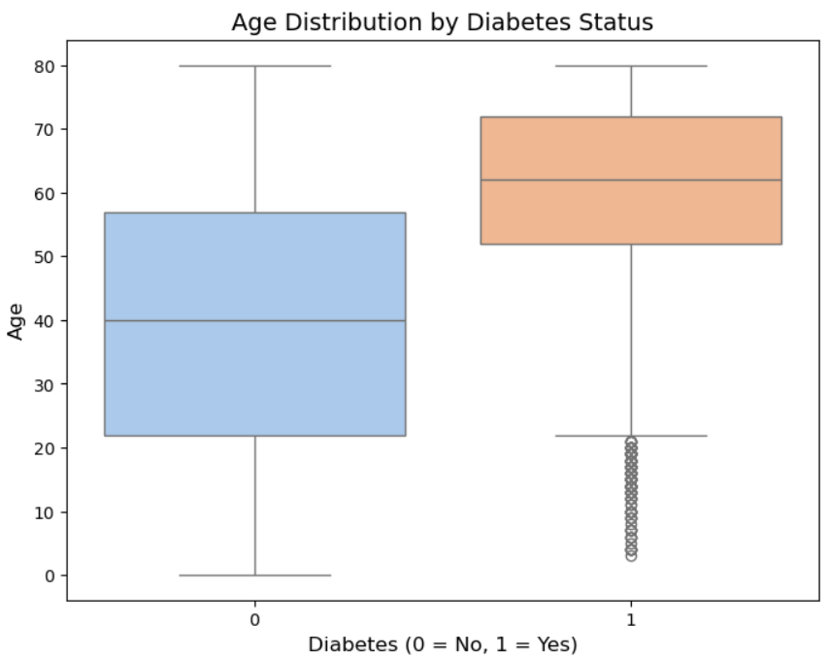
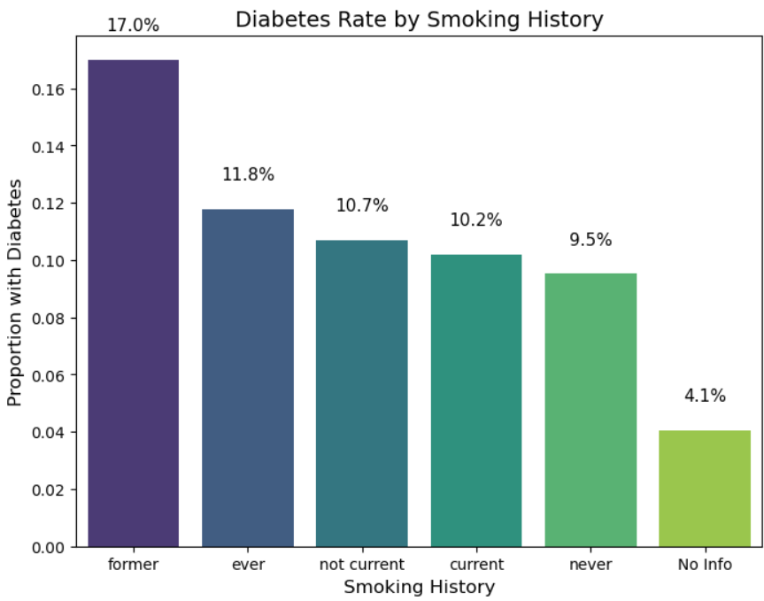
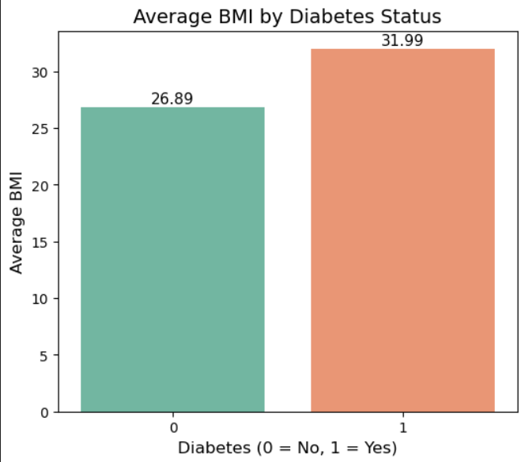
PRELIMINARY ANALYSIS & FINDINGS
age
Higher diabetes rates observed among older individuals (~61 years vs ~40 years non-diabetic individuals)
SMOKING HISTORY
Never smokers show a lower likelihood of diabetes (9.5%), suggesting that avoiding smoking is associated with reduced risk
BMI
Diabetic individuals have higher average BMI (~31) than non-diabetic individuals (~26). Likelhood of diabetes increase with higher BMI

Slide 8
02
reflection
How did our project evolve?

Slide 9
Revised Hypothesis
Initial Hypothesis | Refined Hypothesis
Individuals with higher BMI are more likely to have diabetes. | (Introduce Interaction Terms) Older individuals with higher BMI may have a higher risk of diabetes compared to younger individuals with the same BMI.
Individuals with a history of smoking are more likely to develop diabetes. | (Introduce Interaction Terms) Smoking and heavy alcohol consumption often co-occur and may jointly increase diabetes risk more than each factor alone.
Hypertension or heart disease will increase the risk of diabetes. | Smoking and heavy alcohol consumption often co-occur and may jointly increase diabetes risk more than each factor alone.
Younger individuals are less likely to have diabetes. | Unchanged
Notes:
vanshika

Slide 10
Main Challenges
Synthetic data
Cause vs. Consequences
Problem: Initial dataset was fully synthetic, limiting to support broader generalization
Solution: Incorporated another dataset with comparable features and derived from real survey results.
Challenge: Some variables can be both causes AND consequences of diabetes.
Example: Alcohol Consumption
Causality: Low drinking protects against diabetes
Consequence: Diagnosed patients reduce drinking based on doctor’s recommendation
Notes:
vanshika

Slide 11
03
NEW ANALYSES
What changed?

Slide 12
DATASET
source
SUMMARY
2024 Behavioral Risk Factor Surveillance System (BRFSS) – Calculated Variables File
From the CDC's annual nationwide health survey
Includes binary, categorical, and continuous variables
U.S. health survey that collected self-reported information on:
Physical health
Mental health
Chronic conditions
Healthcare access
Lifestyle behaviors
Notes:
zoe

Slide 13
DATASET FEATURES
General Health & Functioning | Health Conditions | Lifestyle Behaviors | Oral Health | Demographics | Body Metrics
Memory trouble Trouble walking Lack of transport to medical appointment | Heart disease indicator Asthma Arthritis diagnosis Cancer Kidney disease Hearing & vision impairments | Physical activity in past 30 days Cigarette/ e-cig usage Alcohol usage Flu shot | Teeth removed Dental visit in past year | Age Sex Race & Ethnicity Education level Household income Employment status Metro / urban status | Weight BMI
Notes:
zoe

Slide 14
Data exploration and preprocessing
Low multicollinearity
Rename columns
diabetes
Nulls
Keep only clear yes or no
Missing data in most columns
Notes:
zoe

Slide 15
Feature engineering
01
Map
To logical numbers models can understand
SAS format
02
Impute
Missing values when needed
Requires changes for analysis
Dummies
For categorical vars
03
Notes:
zoe

Slide 16
STATISTICAL METHODS Used
Coefficient
P-value
Interaction terms
Picked a few medical/demographic factors to see their interactions.
Used p-value to tell whether the coefficient is statistically meaningful.
Utilized this to interpret the relationship between each feature and the probability of having diabetes.
Notes:
Vanshika
Coef -> Statistically, coefficient means the estimated size and direction of a predictor’s effect on the outcome.
P-value -> P-value is the probability of observing an effect at least as extreme as the one estimated, assuming the null hypothesis is true.
Interacation term -> In statistics, interaction terms are used to capture how the effect of one predictor changes depending on the level of another predictor.

Slide 17
ALTERNATIVE APPROACHES
Linear Regression
Clustering
- Low test and train accuracy
- Regularization brings no change (lasso, ridge, combined)
- Testing unprocessed dataset for greater flexibility (no change)
- Interaction terms bring small value
- Clustering on full dataset, portions (just diabetes), and greater and reduced columns brings little benefit
- Overlaying results shows no clear trend or pattern within population groups
Notes:
Vanshika

Slide 18
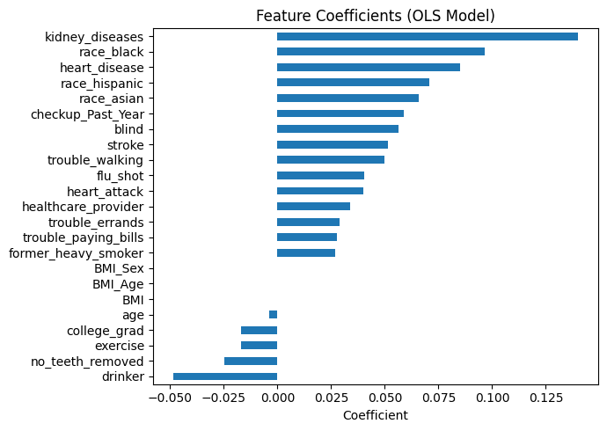
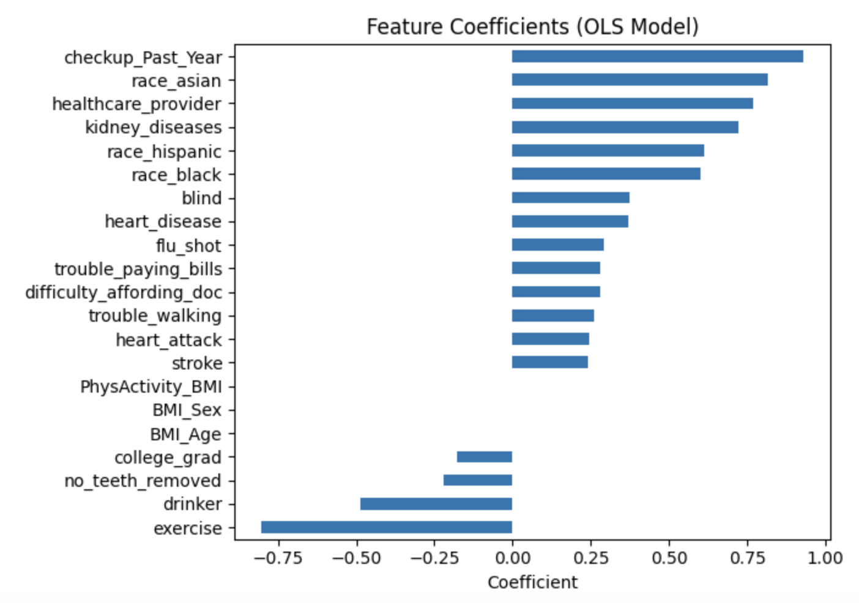

MODEL SELECTION
LINEAR Regression
LOGISTIC Regression
R^2: 0.293
AUC: 0.804

Slide 19
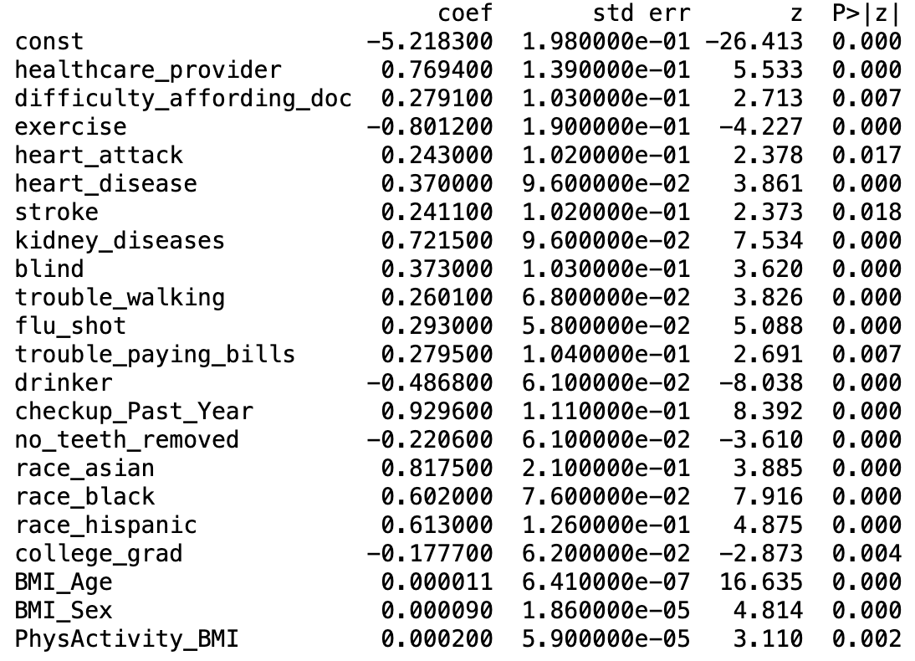
Results of Model
Highest Coefficient — Checkup_Past_Year
Lowest Coefficient — Exercise
Additional Insights
The negative coefficient for Drinker suggests that reduced alcohol consumption may be a behavioral change following a diabetes diagnosis.
Compared with other racial groups, Asians show a higher estimated risk of diabetes in our model.
Interaction terms do not yield interpretable or meaningful effects in this specification.
Notes:
- This variable likely reflects a consequence of having diabetes, as individuals with the condition tend to seek medical checkups more frequently.
- Engaging in regular physical activity appears to reduce the risk of diabetes, consistent with established evidence.

Slide 20
Hypothesis testing
Older people with high BMI may have a higher risk of diabetes compared to younger individuals.
→ Its magnitude is extremely small, and
practical impact is negligible.
Heart disease/heart attack history is likely to increase the probability of diabetes.
→ Heart disease history indicates a moderate
positive relationship with having diabetes.
Younger people are less likely to have diabetes.
Smoking and heavy alcohol consumption often co-occur and may jointly increase diabetes risk more than each factor alone.
→ Its p-value is larger than 0.05 and its
impact not meaningful statistically.
Notes:
monica

Slide 21
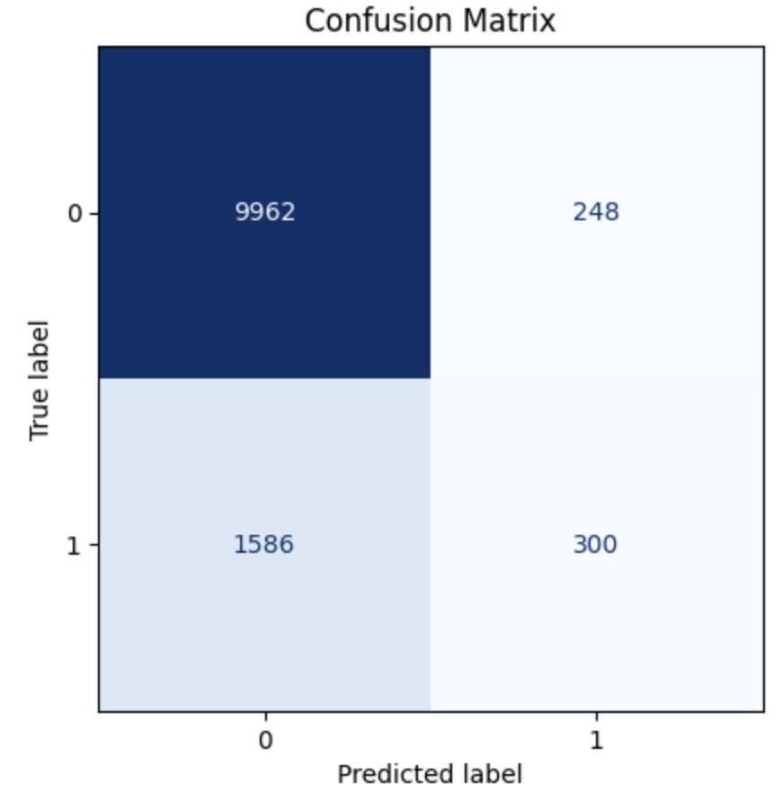
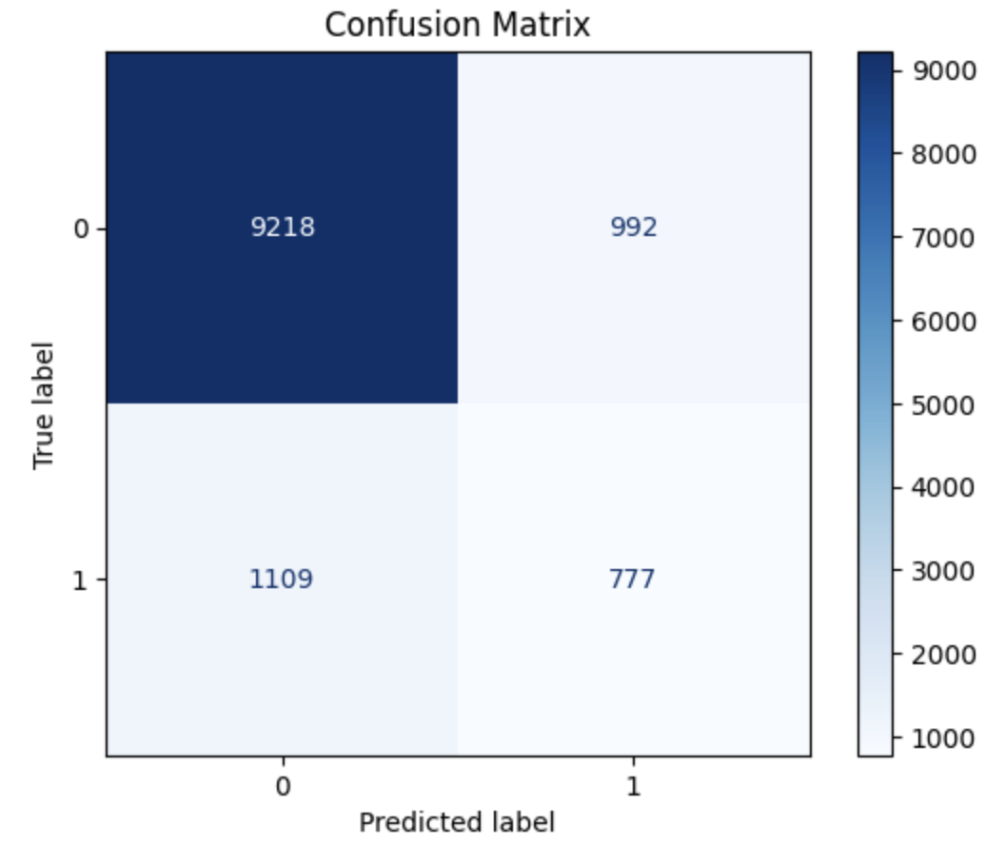
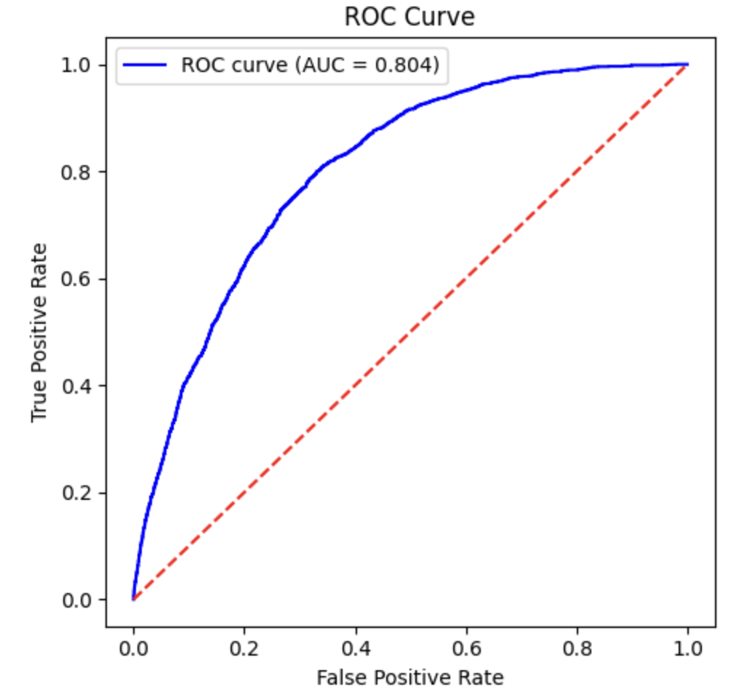
Model accuracy
Confusion Matrix
ROC Curve
Threshold : 0.5
Threshold : 0.3
AUC: 0.804
Given the health context,
minimizing false negatives is essential.
Notes:
monica

Slide 22
Thank you!

